Slide 1
ELEMENT Progress Presentation I
Group ID : 18-025

Slide 2
Group Members
ID number | Name
IT15087584 | S. A. R. V. Silva
IT15035004 | K. D. Y. Viduranga
IT15000354 | Mirando H.N.
IT15003942 | Withanage K.V.N.

Slide 3
Completed Implementation

Slide 4
Data Preprocessing and non-related Review Removal Mechanism
Setting up elasticsearch and kibana
Implementation of elastic client
Implementing configurations
Using java rest client(RestHighLevelClient) to perform different operations on elasticsearch
Using XContentBuilder for indexing
Implementation of Facebook Graph API
Using Spring Social Facebook to use Facebook graph API
Implementing Facebook authorization
Implementing relevant controllers to retrieve data

Slide 5


Text Analysis and Emotion Categorization
Create knowledge-base
Mapping datasets into vector space
Training ML algorithm to classify user comments into emotion categories
Calculate tf (term frequency) value
Calculate idf (inverse document frequency)
D – No. of documents in corpus
d – No. of documents where the term t appears
Calculate tf-idf value
Calculate cosine value (similarities between 2 documents)
similarity(a, b) =cos(θ) = a⋅ b / ||a|| ⋅ ||b||

Slide 6
Suggestion Extraction and Prioritization
Creation of vocabulary
Terminology
Thesaurus
Creation of dataset
Classification of reviews into suggestions and non-suggestions
Tried several algorithms until optimum algorithm is found

Slide 7
Rating measurement and Success Prediction
Representation and calculation of the relationships between the social media metrics
Relationships among the metrics have implemented using statmodels using ARIMA model
Calculation of
Accuracy score
f-score
scores are implemented using random forest machine learning algorithm with test data
Plotting the relationships between the social media metrics using seaborn and matplot library for ARIMA

Slide 8
To Be Implemented

Slide 9
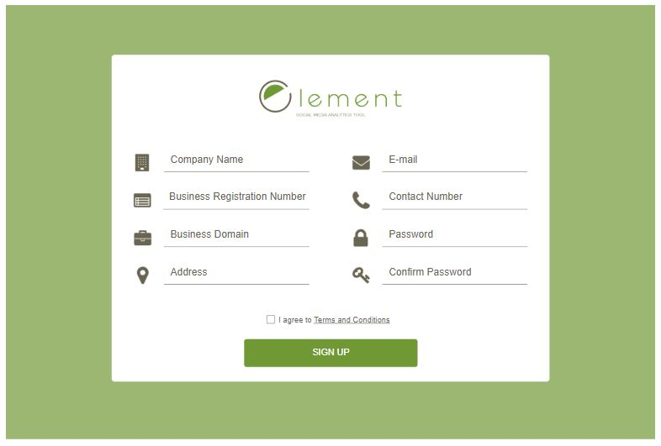
User Interfaces
Registration Page

Slide 10
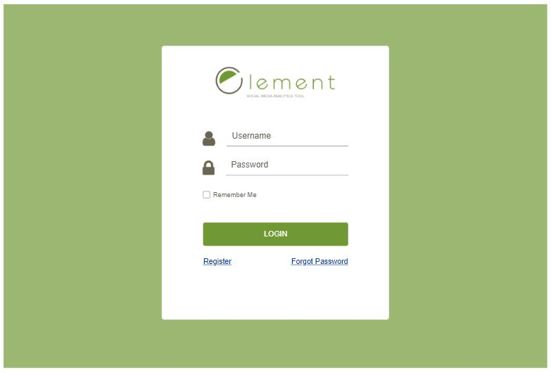
Login Page

Slide 11
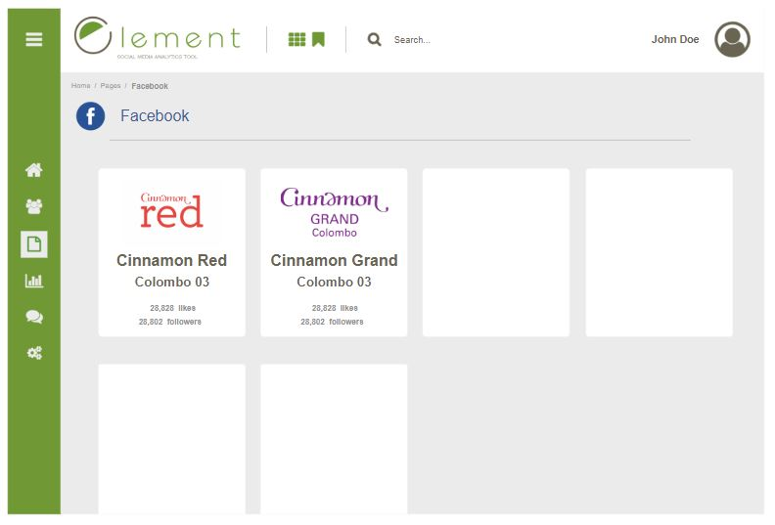
Social Media Pages Page

Slide 12
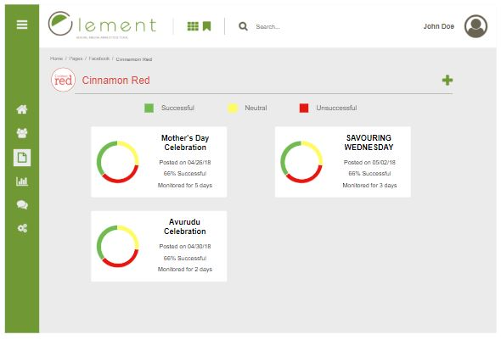
Posts Page

Slide 13
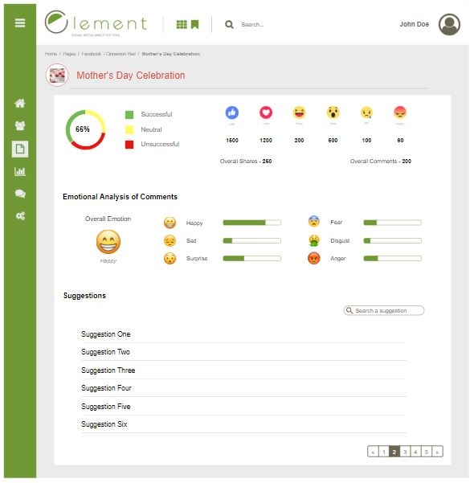
Statistics Page

Slide 14
Data Preprocessing and non-related Review Removal Mechanism
Applying preprocessing techniques on the data retrieved from social media APIs
Spell Check
Grammar checking
Duplicate removal
Stemming and lemmatization
Developing a spam detection mechanism
This mechanism will be used to remove unrelated data from retrieved data from social media APIs.

Slide 15
Text Analysis and Emotion Categorization
Training ML algorithm to classify user comments into emotion categories
Calculate percentage of each emotion category for a post
Designing and implementation of different graph views to show emotion classification results

Slide 16
Suggestion Extraction and Prioritization
Extraction of suggestions from comments
Ontology creation
Semantic analysis of suggestions
Extract related keywords per suggestion and storage in the database
Repetition amount of suggestion
Comparison of stored keywords and increment the count for one suggestion if matched and vice versa

Slide 17
Rating measurement and Success Prediction
Making the accuracy level high with real world data and get the comments categorization to predict the success rate
Predicting the success rate by making the relationships between the best f score
Converting the f-score to the percentage for display the success rate
Display descriptive statistical details of the post in Dashboard

Slide 18
Thank You!

